Slide 1

DEPARTMENT OF INFORMATION TECHNOLOGY
“REAL TIME OBJECT DETECTION USING YOLO ALGORITHM”
Batch No –9
VIGNESHKUMAR V(212220220054)
SATHISH KUMAR M(212220220042)
Under the guidance of:
Prof. Suresh Kumar, M TECH,PH.D

Slide 2
AGENDA
INTRODUCTION
OBJECTIVE
SCOPE
LITERATURE SURVEY (in Tabular column)
EXISTING SYSTEM & DRAW BACKS
PROBLEM DEFINITION
PROPOSED SYSTEM
SYSTEM ARCHITECTURE
MODULES (with Description and Flowchart/ UML/ Pseudo Code)
OUTPUTS (Screen shorts and Results/Graphs)
SWOT Analysis
CONCLUSION
FUTURE ENHANCEMENT
REFERENCES

Slide 3
INTRODUCTION
Object detection is a technology that detects the semantic objects of a class in digital images and videos.
One of its real-time applications is self-driving cars. In this, our task is to detect multiple objects from an image.
The most common object to detect in this application is the car, motorcycle, and pedestrian.
For locating the objects in the image we use Object Localization and have to locate more than one object in real-time systems

Slide 4
OBJECTIVE
Identify all target objects in the target image and determine the categories and position information in order to achieve machine vision understanding.
When humans look at images or video, we can recognize and locate objects of interest within a matter of moments. The goal of object detection is to replicate this intelligence using a computer
It comprehensively includes a variety of important techniques, such as image processing, pattern recognition, artificial intelligence and machine learning.

Slide 5
SCOPE
In real life, to achieve this goal, besides hardware development, we need the software that can enable robot the intelligence to do the work and act independently.
One of the crucial components regarding this is vision, apart from other types of intelligences such as learning and cognitive thinking
A robot cannot be too intelligent if it cannot see and adapt to a dynamic environment

Slide 6
LITERATURE SURVEY
YEAR | AUTHOR | TITLE& ARCHITECTURE | DOMAIN & PROBLEM STATEMENT | CONCLUSION & RESULT
2016 | joseph Redmon, Santosh Divvala, Ross Girshick, Ali FarhadI | You Only Look Once: Unified, Real-Time Object Detection | A fast and simple approach to detecting real time images was introduced in this paper as You Only Look Once. The model was built to detect images accurately | In comparison with Object detectiontechniques that came before YOLOl ike R-CNN, . This meant that YOLOperformed much faster
2018 | Chengji Liu, Yufan Tao, Jiawei Liang, Kai Li1, Yihang Chen | Object Detection Based on YOLO Network | A generalized object detection network was developed by applying complex degradation processes on training sets like noise, blurring, rotating and cropping of images | The experiment showed that the model trained with the standard sets does not have good generalization ability for the degraded images and has poor robustness

Slide 7
LITERATURE SURVEY
2018 | Wenbo Lan, Jianwu Dang, Yang- ping Wang, Song Wan | Pedestrian Detection Based on YOLO Network ModeL | The network structure of YOLO algorithm is improved and a new network structure YOLO-R was proposed to increase the ability of the network | The YOLO v2 and YOLO-R network models were tested on the test set of the INRIA data set. The experimental results show that the YOLO-R
2018 | Rumin Zhang, Yifeng Yang | An Algorithm for Obstacle Detection based on YOLO and Light Filed Camera | An obstacle detection algorithm in the indoor environment is proposed which combines the YOLO object detection algorithm and the light field camera and will classify objects i | The images of the common obstacles were labeled and used for training YOLO. The object filter is applied to remove the unconcern obstacle.
2019 | Zhimin Mo1, Liding Chen1, Wen-jing You | Identification and Detection of Automotive Door Panel Solder Joints based on YOLO | A method for identifying the solder joints of automotive door panels based on YOLO algorithm that provides the type and location of solder joints in real time | The YOLO algorithm, proposed identifies the position of the solder joints accurately in real time

Slide 8
EXISTING SYSTEM
We Implemented in two stages:
We select regions of interest in an image.
We classify these regions using convolutional neural network.
Instead of selecting interesting parts of an image, we predict classes and bounding boxes for the whole image in one run of the algorithm. The two best-known examples from this group are the YOLO (You Only Look Once) family algorithms.

Slide 9
DRAW BACKS
Small object detection, such as a ﬂock of birds, is a problem as there is a spatial restriction on bounding boxes with each cell being able to predict only two boxes and have one class.
Problems when generalizing objects of abnormal aspect ratios and conﬁgurations.
Loss function will treat the errors of small or large bounding boxes as same

Slide 10
PROBLEM DEFINITION
The problem definition of object detection is to determine where objects are located in a given image (object localization) and which category each object belongs to (object classifica- tion)
Object detection is the problem of finding and classifying a variable number of objects on an image. The important difference is the “variable” part

Slide 11
PROPOSED SYSTEM
Architecture describes how the application is going to function
Project Architecture of Object Detection describes how the user’s request is taken as input and how the output is delivered
Object proposal aims to generate a certain amount of candidate bounding boxes to determine the potential objects and their locations in an image, which is widely applied to many visual tasks for pre-processing

Slide 12
SYSTEM ARCHITECTURE
YOLOv4 is designed based on recent research findings
Using CSPDarknet53 as a Backbone,
SPP (Spatial pyramid pooling)
PAN (Path Aggregation Network) for what is referred to as “the Neck”
YOLOv3for “the Head”

Slide 13
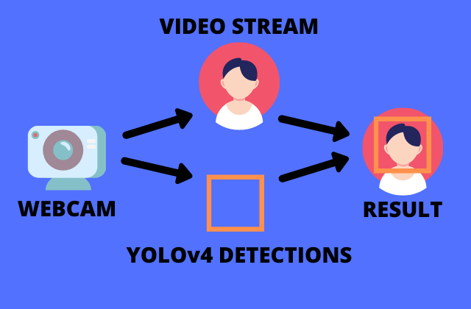
SYSTEM ARCHITECTURE

Slide 14
MODULES
YOLO module perform four functionalities
Object Registration: This module allows the object to be registered with the model
Object Detection: This module allows the product to detect the object based on the training received
Frame Analysis: This module allows the model to analyze the capture frame.
Generate Prediction: This module allows the module to generate a text prediction of what the object is and where the object is present Workflow is stated with use case diagram.

Slide 15
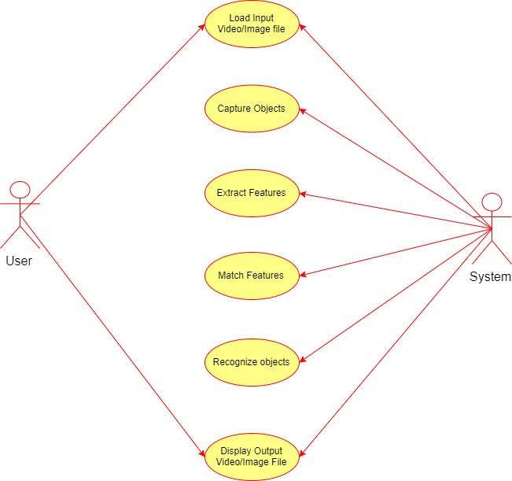
Use Case Diagram

Slide 16
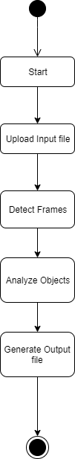
Activity Diagram

Slide 17
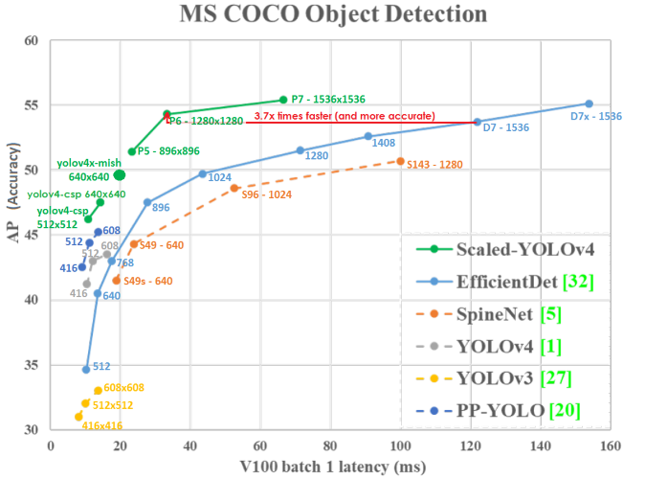
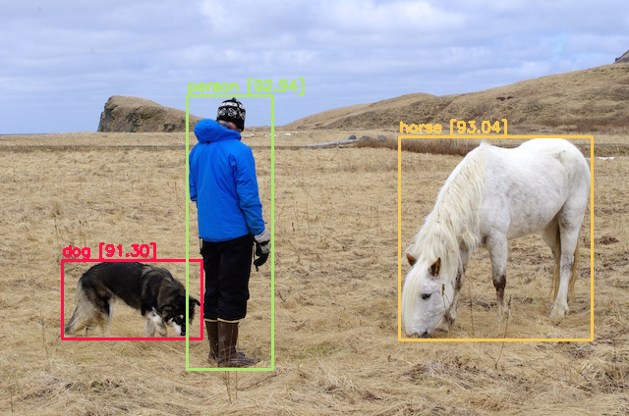
OUTPUTS

Slide 18
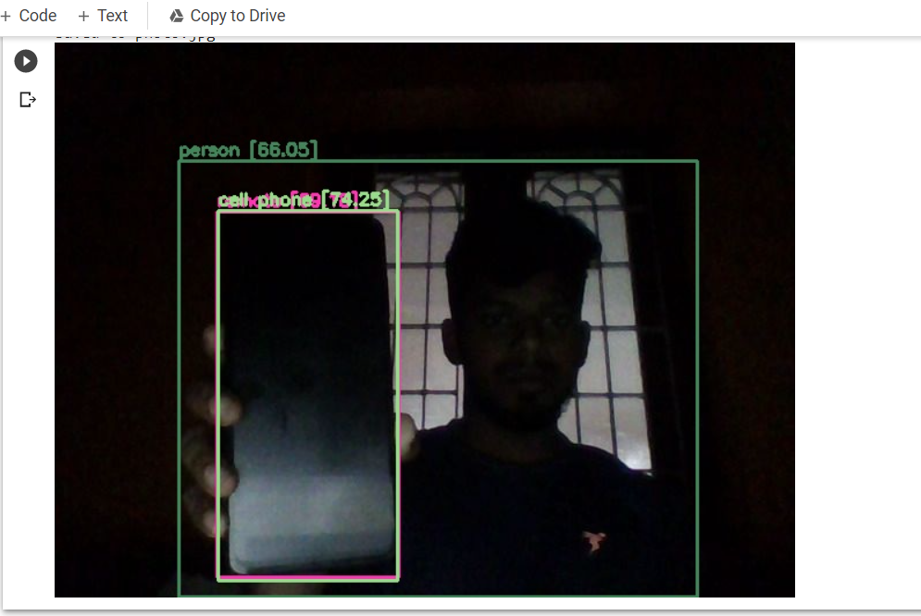
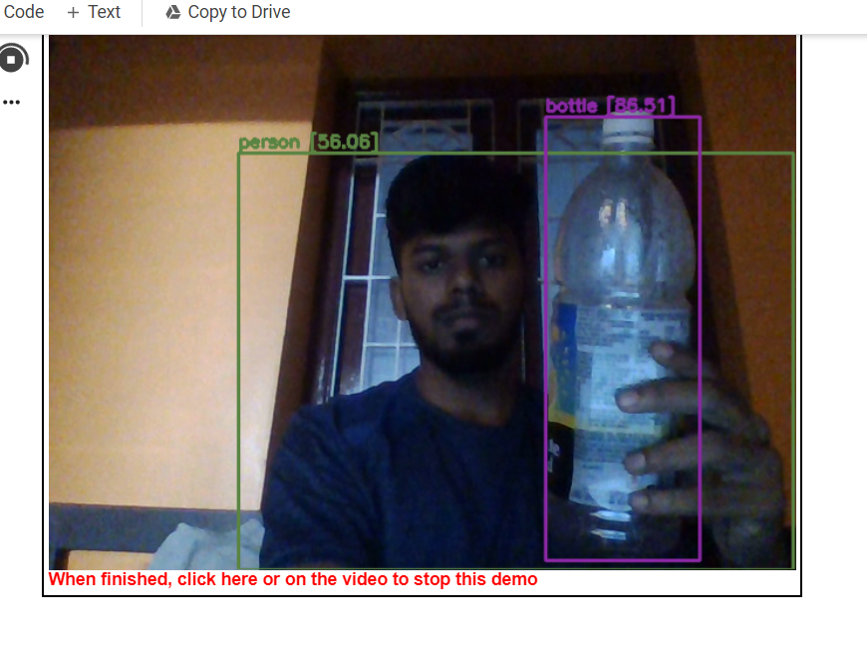
OUTPUTS

Slide 19
SWOT Analysis
STRENGTH
Partitioning an image into objects is akin to the way humans conceptually organize the landscape to comprehend it. 
Using image-objects as basic units reduces computational classifier load by orders of magnitude, and at the same time enables the user to take advantage of more complex techniques (e.g. non-parametric)
WEAKNESSES
Under the guise of ‘flexibility’ current commercial objectbased software provides overly complicated options.
 There are numerous challenges involved in processing very large datasets
Even if OBIA is more efficient than pixel-based approaches

Slide 20
THREATS
The visual appeal of image-objects, their easy GISintegration
Enhanced classification possibilities have attracted the attention of major RS image processing vendors, who are increasingly incorporating new segmentation tools into their packages.
OPPORTUNITIES
Object-Oriented concepts and methods have been successfully applied to many different problems, not only computer languages, and they can be easily adapted to OBIA.
This integration not only includes OO programming,

Slide 21
CONCLUSION
By using this based on experimental results we are able to detect object more precisely
Identify the objects individually with exact location of an object in the picture in x,y axis.
We Provide experimental results on different methods for object detection and identification
Compares each method for their efficiencies

Slide 22
FUTURE ENHANCEMENT
An object recognition system is developed, that recognizes the two-dimensional and three dimensional objects.
The feature extracted is sufficient for recognizing the object and marking the location of the object. x The proposed classifier is able to recognize the object in less computational cost.
The proposed global feature extraction requires less time, compared to the traditional feature extraction method.
The performance of the SVM-kNN is greater and promising when compared with the BPN and SVM.
The performance of the One-against-One classifier is efficient

Slide 23
REFERENCES
Joseph Redmon,Santosh Divvala,Ross Girshick,Ali Farhadi. ”You Only Look Once: Uniﬁed, Real-Time Object Detection” [J].2016 IEEE Conference on Computer Vision and Pattern Recognition (CVPR),2016:779788.
Chengji Liu ,Yufan Tao ,Jiawei Liang ,Kai Li1 ,Yihang Chen, ”Object Detection Based on YOLO Network” 2018 IEEE 4th Information Technology and Mechatronics Engineering Conference (ITOEC 2018)
Wenbo Lan, Jianwu Dang, Yangping Wang and Song Wang, ”Pedestrian Detection Based on YOLO Network Model” 978-1-5386-60751/18/$31.00 ©2018 IEEE

Slide 24
REFERENCES
Rumin Zhang, Yifeng Yang, ”An Algorithm for Obstacle Detection based on YOLO and Light Filed Camera”, 2018 Twelfth International Conference on Sensing Technology (ICST)
Zhimin Mo1, Liding Chen1, Wenjing You1 ”Identiﬁcation and Detection of Automotive Door Panel Solder Joints based on YOLO” 978-1-72810106-4/19$31.00 ©2019 IEEE
M. Everingham, S. M. A. Eslami, L. Van Gool, C. K. I. Williams, J. Winn, and A. Zisserman. The pascal visual object classes challenge: A retrospective. International Journal of Computer Vision, 111(1):98–136, Jan. 2015

Slide 25

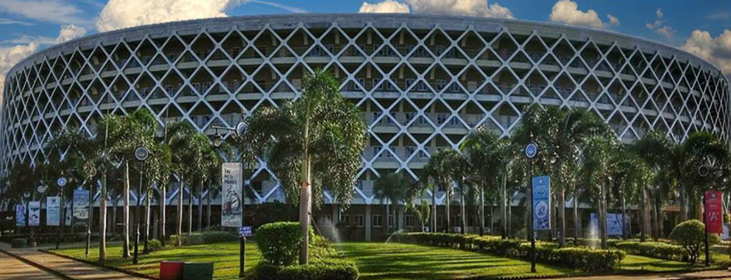
THANK YOU

